Slide 1
Regulamento OFCOM
Implementing TV White Spaces
Fev/2015
Mauro Vieira de Lima
Março/2015

Slide 2
AGENDA
OFCOM Implementing TV White Spaces
Executive Summary
TV White Spaces framework
Coexistence approach
Coexistence in relation to DTT
Coexistence in relation to users above and below the TV band and cross border
Approach to determining WSD emission limits
Andamento da pesquisa

Slide 3
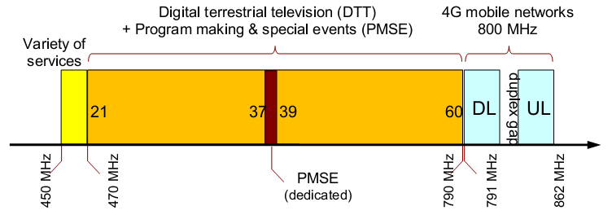
Executive Summary
This document sets out Ofcom’s decision to move ahead and enable access to unused parts of the radio spectrum in the 470 to 790 MHz frequency band through dynamic sharing controlled by a spectrum database.
We refer to the spectrum that is left over by Digital Terrestrial Television (DTT) (including local TV) and Programme Making and Special Events (PMSE) use as TV white spaces (TVWS).
We intend to make available access to TV white spaces on a licence exempt basis for devices which meet a minimum technical specification.
Devices which know their location, combined with databases, which know where existing services are, will be used to ensure services can coexist sharing the spectrum.
We have decided to make some changes to the coexistence proposals that were set out in the 2013 Consultation.

Slide 4
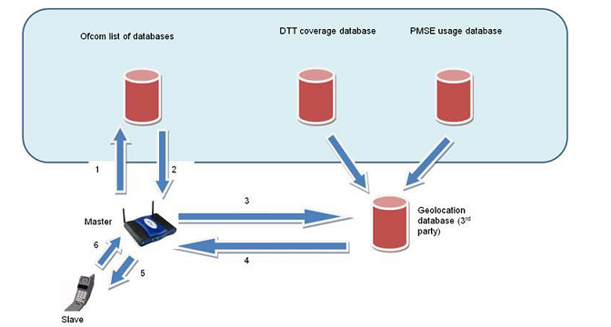
TV White Spaces framework
Database discovery
Master white space device (WSD) would first consult a list of databases provided on a website hosted by Ofcom (1 and 2). It would then select its preferred database from this list and send to it parameters describing its location and device parameters (3). The database would then return details of the frequencies and power levels the WSD is allowed to use (4). Initially, we would expect master WSDs to download an updated copy of the list every 24 hours. Database discovery will not be carried out by transmissions over TV white space.

Slide 5
TV White Spaces framework
Four data sets that Ofcom will provide to a white space databases (WSDB):
“DTT Coexistence data”: set of data containing the maximum allowed powers a WSD can transmit at in each 100 x 100 m pixel
“Location Agnostic data”: additional constraints that relate to taking account of PMSE use of channel 38.
“PMSE data”: information on licensed PMSE use in the band (other than in channel 38).
“Unscheduled Adjustments data”: revised allowed power limits that we may introduce at a particular geographical area on an ad hoc basis.
Device parameters:
Master WSD will report to that database its “device parameters” which identify specific characteristics of the WSD. “ETSI Harmonised Standard” (EN 301 59814).
Operational parameters:
WSDBs will use device parameters together with information provided to them by Ofcom, to determine what frequencies are available for that particular device and at what powers it is able to transmit. only be valid for a short period of time so the device will have to query the database on a regular basis.
Channel usage parameters:
WSD will decide which specific channels and power levels it wants to use. It will then report this information back to the WSDB, which will make it available to Ofcom.

Slide 6
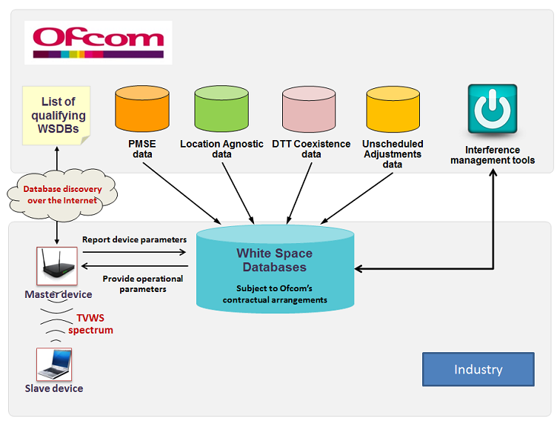
TV White Spaces framework

Slide 7
TV White Spaces framework
Exchange parameters between WSDs and WSDB:
Master WSD will request “generic operational parameters” from the WSDB. These are the channels and powers that a generic slave device can use. Master WSD will broadcast generic operational parameters
Slave WSDs could continue using the generic operational parameters or could provide the master with additional information (location). Master would then relay this information to the WSDB, which would calculate “specific operational parameters” for a particular slave.
Master WSD will also have to report the slave WSD’s channel usage parameters to the qualifying WSDB from which it has obtained operational parameters
Interference management:
WSDBs will make available to Ofcom an information system, “White Space Devices Information System” (WSDIS), that provides information for the purposes of carrying out an initial triage of interference cases.
Ofcom will be able to: (i) instruct WSDBs to require a particular WSD to cease transmission. (ii) provide to a WSDB a set of new maximum power limits for a particular location and channels “Unscheduled Adjustments data”. (iii) instruct a WSDB to cease providing some or all WSDB services.
WSDBs will operate independently of each other. In the future, it may become desirable for the provision of WSDB services to have information about other WSDBs’ operations.

Slide 8
Coexistence approach
Multiple WSDs and interference aggregation:
We have implicitly assumed that at any one time only one WSD radiates per pixel/location and per DTT channel.
In practice, a WSDB may provide services to multiple WSDs in the same geographic area and the same DTT channels. This may result in an aggregation of interferer signal powers.
We believe that such aggregation of interference is unlikely to be problematic in the short term, for the following reasons:
devices (in particular mobile devices) rarely transmit at the full power.
Received power reduces rapidly with increasing geographic and frequency separation from a transmitter
many will implement polite protocols, such as “listen-before talk” in Wi-Fi.
The emission limits include implicit margins which will provide some mitigation of interference aggregation.
NÃO DEFINE COMO FAZER A ALOCAÇÃO DE POTÊNCIA DOS WSD

Slide 9
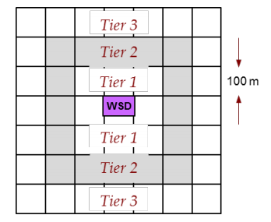
Coexistence in relation to DTT
We expect to only take into account one single transmitter for a given pixel. Intention is to protect the transmitter in actual use in each location. We use an existing industry DTT planning tool (UKPM). Not expect that WSD co-channel use will occur in practice. There is an overall cap of 36 dBm/(8 MHz) regardless of class, type or location of device.
DTT network is planned for reception using rooftop aerials, not indoor aerials. Parameters we have set out to ensure a low probability of harmful interference to viewers using rooftop aerials.
Classify protection ratios in two categories: “high” and “low”. “High” reflects the “stop/start” behaviour to which some DTT receivers are particularly sensitive.
WSDs are classified into one of five classes, by comparing devices out of band emissions to a table with reference values for each device (the mask).
We do not know where within a pixel DTT receivers are, which introduces two questions. One is the distance between the WSD and the DTT receiver. The other is whether the TV aerial will be pointing directly at the WSD. How we deal with uncertainty about the location of DTT receivers:
Tiers 0/1: rely on statistics for both the distance between WSD and DTT and antenna pointing.
Tier 2: rely on statistics for the distance between the two, but use the angle between the two pixels.
Tiers 3 and above: use the distance and angle.

Slide 10
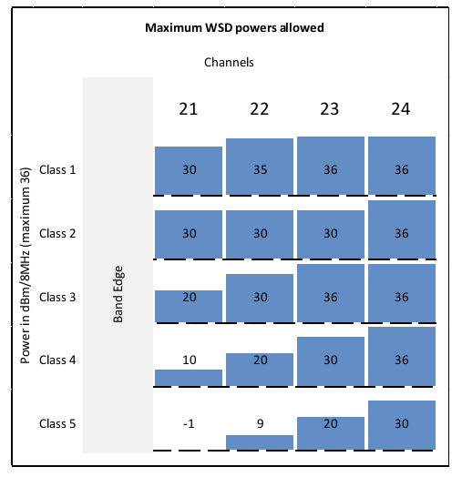
Coexistence in relation to users above and below the TV band and cross border
Services below the UHF TV band
There are a large number of different users of spectrum close to the lower end of the UHF TV band, between 450 and 470MHz. Power restrictions on WSDs operating in the lower section of the UHF TV band (in channels 21 to 24):
Services above the UHF TV band
The frequencies immediately above the UHF TV band are used for 4G mobile. It is not allow WSDs to operate in channel 60 (the closest to 4G services).
Cross-border issues
Trigger field strength levels determining power levels for WSDs. GE06 Plan specifies the following trigger Field strength levels used for the protection of broadcasting services:

Slide 11
Approach to determining WSD emission limits
Ofcom will calculate the EIRP limits at all locations and all DTT channels 21 to 60, accounting for five WSD spectrum emission classes, two protection ratio categories and seven representative WSD antenna heights, all for type A WSDs (7×5×2 = 70 datasets for each channel and pixel).
WSDBs can then infer the EIRP limits for type B by adding an appropriate building penetration gain (depending on the WSD height) and body gain (0 dB).
Pixel is considered served by DTT if the location probability for that pixel exceeds 70%. Not all channels in a pixel are protected. This might be because for some channels the estimate of location probability falls below a 70% threshold.
DTT pixel is unpopulated, then it is by definition not protected (not include it in our calculations).
DTT pixel is served by certain protected TV transmitters via a number of protected DTT channels, then we do not include other DTT transmitters and channels in our calculations for that DTT pixel.
For a given WSD location, it is not necessary to examine all DTT receiver pixels,. Pixels beyond a distance R_{REL} would not affect the WSD regulatory limits. R_{REL} will be 20 km for co-channel, and 2 km for adjacent channel calculations. (R_{REL}=20km →125,664 elements; R_{REL}=2km → 1257 elements).
Dist=2km → FSL= 92.5dB → Ptx=36 → Prx=-56.5 → PR=-36 → Pinterf=-92.5; SINR=(-75.5+92.5)=17dB

Slide 12
Approach to determining WSD emission limits
Notation:
• i_{WSD} → WSD transmitter location/pixel index.
• F_{WSD} → WSD channel index, 21 to 60.
• i_{DTT} → DTT receiver location/pixel index.
• F_{DTT} → DTT channel index, 21 to 60.
• l_{DTT} → DTT transmitter index
WSD regulatory emission limit:
WSD EIRP P_{WSD}(F_{WSD}, F_{DTT}, i_{WSD} , i_{DTT} , l_{DTT}) will be calculated as a function of the coupling gain G, protection ratio r, and maximum permitted nuisance power Z.
G, coupling gain is the sum (in dB) of propagation gain (path loss) and DTT receiver antenna installation gain (distance and angular discrimination).
r, protection ratio specifies the ratio of received wanted over unwanted power at the point of receiver failure (frequency discrimination).
Z, maximum permitted nuisance power, relates to the maximum amount of unwanted power a DTT receiver can tolerate.

Slide 13
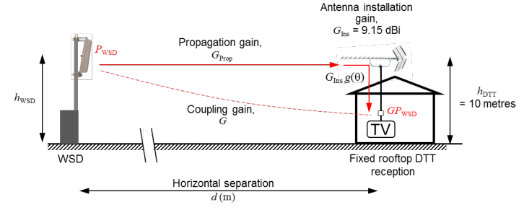
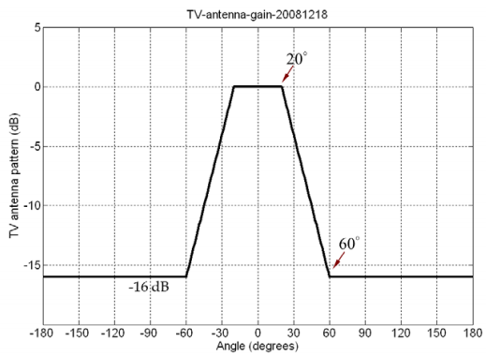
Approach to determining WSD emission limits
Coupling gain G
Propagation gain: Extended Hata (as specified by SEAMCAT) to model propagation gain. Not account for terrain. DTT height h_{DTT} set to 10 metres. WSD height h_{WSD} is variable. Use open, suburban, and urban modes of extended Hata depending on the clutter type at DTT location.
Antenna gain: consider antenna gain as the combination:
antenna installation gain G_{Ins}, which represents the net
gain of the DTT receiver antenna gain including cable loss.
Assume a default DTT receiver antenna installation gain
of GIns = 9.15 dB.
(ii) antenna angular discrimination g.
Model g(φ) based on the ITU-R BT.419-3 pattern.
Do not account for any polarisation discrimination.

Slide 14
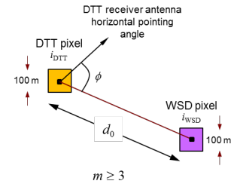
Approach to determining WSD emission limits
Coupling gain G also add:
Building penetration:
Type A (fixed outdoor) WSDs, we will use a building penetration gain of G_{BP} = 0 dB.
Type B (portable/mobile) WSDs, if h_{WSD} > 2 metres → G_{BP} = - 7 dB. Otherwise, GBP = 0 dB
Body gain of G_{B} = 0 dB for both Type A and Type B WSDs.
Tier 3 pixels and beyond: DTT pixel of interest is among the m^{th} tier (m ≥ 3) of pixels that surround the pixel within which the WSD is located.
Derive the coupling gain for the WSD-DTTpixel pair
(i_{WSD}, i_{DTT}) by calculating the propagation gain
according to the geographic separation between
the centres of the two pixels.
Complement the propagation gain with
the addition of a DTT receiver installation
gain of G_{Ins}= 9.15 dB and an angular
discrimination gain g(Φ).
WSD antenna height h_{WSD} is reported, then it will be rounded to the nearest of heights 1.5, 5, 10, 15, 20, and 30 metres. If antenna height is not reported: (i) type A WSD: set to 30 metres, (ii) type B WSD set to 1.5 metres.

Slide 15
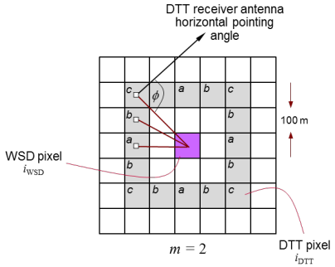
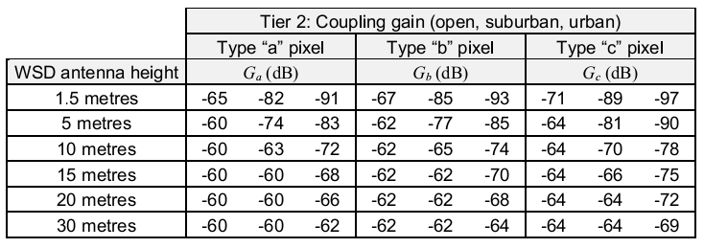
Approach to determining WSD emission limits
Tier 2 pixels: DTT pixel of interest is among the 2nd tier (m = 2) of pixels that surround the pixel within which the WSD is located.
Geometry for tier 2 pixels, with three types of WSD/DTT pixel geometries. The coupling gains (excluding antenna angular discrimination) to pixel
types a, b, and c are specified as Ga, Gb and Gc, respectively.
Specifically, we have for i={1..16}:
G_{i}(dB) = Ga,b,c (dB) + g(Φ_{i}) (dB)
Values of the reference coupling gains Ga, Gb and Gc are pre-defined by Ofcom and are presented in Table below. These are the 90th percentile values derived based on a uniform random distribution of WSD transmitter and DTT receiver locations in the relevant pixels.
Coupling gain values in the
table are quoted at 474 MHz.
Values at a frequency f MHz
(center frequency of DTT
channel) can be derived by
adding:
20 log₁₀(474/f)

Slide 16
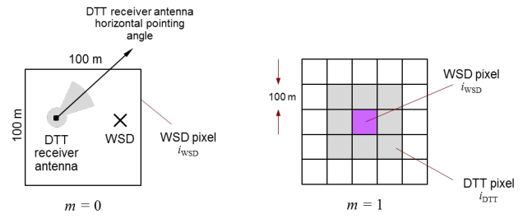
Approach to determining WSD emission limits
Tier 0/1 pixels: DTT pixel of interest is the same as (tier 0) or immediately adjacent to (tier 1) the pixel within which the WSD is located.
Reference coupling gains G₀ are pre-defined by Ofcom and are presented in Table below. These are the 90th percentile values derived based on a random distribution of DTT receiver locations around a WSD for a number of WSD antenna heights. The G₀ values include propagation gain, a DTT receiver installation gain of GIns= 9.15 dB, and DTT receiver angular discrimination g(Φ).
Coupling gain values in the table are quoted at 474 MHz. Values at a frequency f MHz (center frequency of DTT channel) can be derived by adding: 20 log₁₀(474/f)

Slide 17
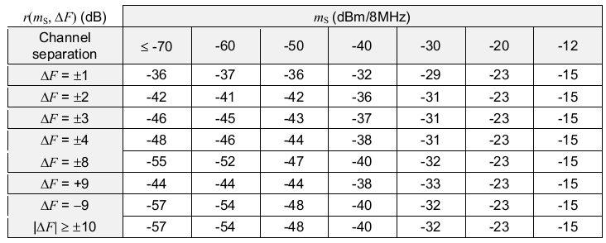
Approach to determining WSD emission limits
Calculating the protection ratio r
Co-channel operation (ΔF = 0), the protection ratio is effectively the signal-to-interference ratio at the point of failure.
ΔF ≠ 0, the protection ratio is a function of the adjacent channel leakage ratio (ACLR) of the WSD signal into adjacent DTT channels, as well as the adjacent channel selectivity (ACS) of the DTT receiver.
We also model protection ratios as a function of the received median wanted DTT signal power m_{S}. This dependency implicitly characterises the non-linear behaviour.
“low” and “high” categories correspond to a WSD device driven by time-continuous and time-discontinuous (gated) traffic. Tables A2.5 (a) (b) (c) (d) (e) and Tables A2.6 (a) (b) (c) (d) (e) describe the “low” and “high” categories of protection ratio for the five class of WSD.
Exemplo:
Tables A2.5 (a) low class 1 →

Slide 18
Approach to determining WSD emission limits
Calculating the nuisance power Z
DTT coverage at this location and in this channel is quantified via the estimated location probability
Models P_{S} and U as log-normal random variables: P_{S} (dBm) ~ N(m_{S} ,σ_{S}²) and U(dBm) ~ N(m_{U} ,σ_{U}²). Then, we can use these values to calculate:
Calculates location probability with the DTT wanted and unwanted powers modelled at the 50% time and 1% time levels, respectively. WSD interferer reduces the DTT location probability from q1 to q2.
For any specific interference scenario/geometry, G, r(ΔF, m_{S}), P_{WSD} and hence Z, are all deterministic variables.
Given a target reduction Δq_{T ,} we can calculate the maximum permitted nuisance power Z_{T}, and then divide by {G . r(ΔF, m_{S}), } to calculate the maximum permitted WSD EIRP. We will set the target reduction in location probability to seven percentage points: Δq_{T} = 0.07.

Slide 19
Approach to determining WSD emission limits
A maximum reduction of 7 percentage points in DTT location probability corresponds to a 1 dB rise in the noise floor at the noise-limited edge of DTT coverage and is what we proposed in our 2013 Consultation.
Calculating the nuisance power Z
There are no closed-form solutions for calculating Z. Iterative numerical (Monte Carlo) and semi-analytical solutions are possible. For an iterative semi-analytical solution see: V.Petrini, H.R.Karimi, “TV white space databases: Algorithms for the calculation of maximum permitted radiated power levels”.
Initialize: Select an initial value, P_{WSD}
1) Calculate m_{Z}= r(Δf, m_{S}) + m_{G}+ P_{WSD}.
2) Use Schwartz-Yeh to derive m_{Y} and σ_{Y.} Obs.: Y(dBm) ~ N(m_{Y} ,σ_{Y}²) e Y=
3) Calculate the reduced location probability as
4) If q₂ is suitably close to q₁-Δq_{T} , then STOP, otherwise appropriately increment/decrement P_{WSD} and go to (1).
Terminate: The maximum permitted WSD EIRP= P_{WSD}

Slide 20
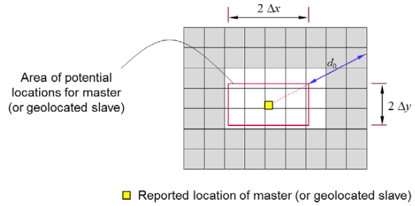
Approach to determining WSD emission limits
Uncertainty in the location of master and geolocated slave WSDs
Reported location (x0, y0) and location uncertainties (± Δx, ± Δy), the area of potential locations shall be modelled as a rectangle centred on (x0, y0), and with sides of length 2Δx and 2Δy aligned with the North-South/East-West directions. If this area of potential locations overlaps (fully or partially) with N pixels, then the master WSD shall be associated with those same N pixels.
Accounting for location uncertainty of a master WSD. The WSD emission limit shall be the lowest of the emission limits in each of the white pixels:

Slide 21
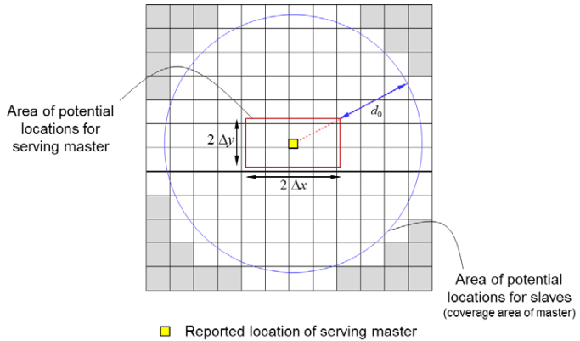
Approach to determining WSD emission limits
Uncertainty in the location of non-geolocated slave WSDs
If a slave WSD is not geolocated, then the WSD shall be associated with pixels which overlap with the coverage area of its serving master WSD. Potential locations shall be modelled as a circle centred on (x0, y0), and with radius d0 + √(Δx²+ Δy²), where d0 is the coverage range of the master WSD.
Accounting for location uncertainty of a non-geolocated slave WSD. The WSD emission limit shall be the lowest of the emission limits in each of the white pixels:

Slide 22
Approach to determining WSD emission limits
Averaging for tier 0/1 pixels
Given a WSD pixel i_{WSD}, we calculate a single value for the maximum permitted WSD EIRP in channel F_{WSD} for protecting channel F_{DTT} in all the nine surrounding tier 0/1 pixels. We do this by taking the average value (in dBm) of the respective maximum permitted WSD EIRPs for protecting channel F_{DTT} in each of the surrounding nine tier 0/1 DTT receiver pixels.
In the above equation, averaging is over DTT pixels i_{DTT}, and the result of averaging has both l_{DTT} (transmitter) and F_{DTT} (channel) as arguments.

